Slide 1









Admin Login
Client Login
Amazon
Route 53
Amazon
Cognito
Amazon API Gateway
Amazon
SES
Amazon
S3
AWS
Lambda
Amazon
SNS

Slide 2
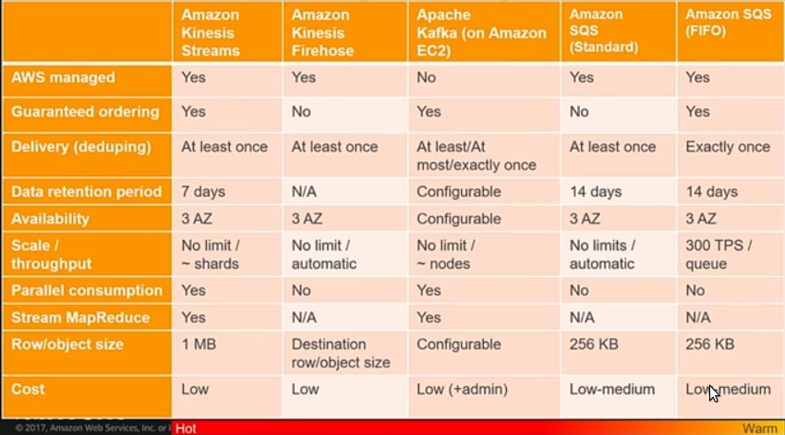
Stream Message details

Slide 3
Storge types
In memory | AWS ElastiCache, DAX, SAP HANA
Graph DB | Neo4j, JanusGraph, TinkerPop
NoSQL | DynamoDB, HBASE, Cassandra, MongoDb
SQL | RDS, Aurora, MySQL, PostGres, Oracle, SQL Server
Search | ElasticSearch, AWS ElasticSearch, AWS CloudSearch

Slide 4
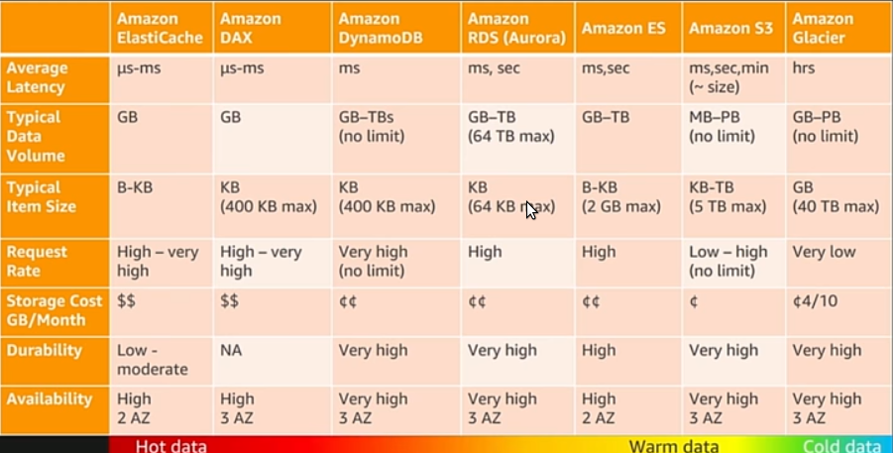
DB Speed details

Slide 5
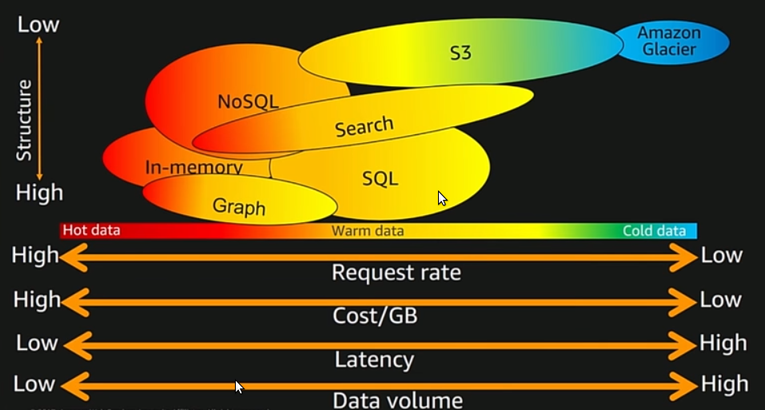
DB Structure vs speed

Slide 6
NoSQL DBs
Key Value | Redis, Oracle BDB, Amazon Dynamo, Riak | - Key value access - most flexible - Efficient and Scalable Not good as transactional DB
Document | Couch DB, MongoDB, Amazon Dynamo | - Value is single document - Documents can have different structure
Wide Column | Hbase, Apache Cassandra | - Column Family - High performance and scalable
Graph Stores | Noe4J, InfoGrid, Infinite Graph | - Focus on relationship - Nodes and Edges

Slide 7
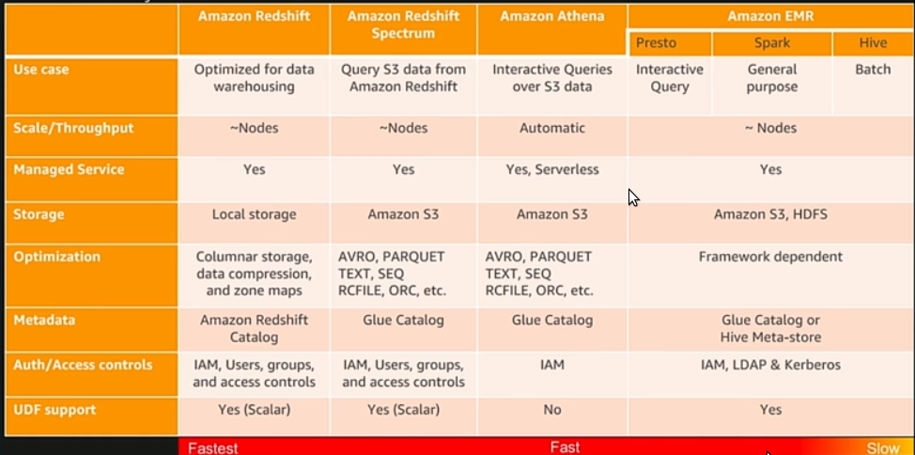
Analytics

Slide 8
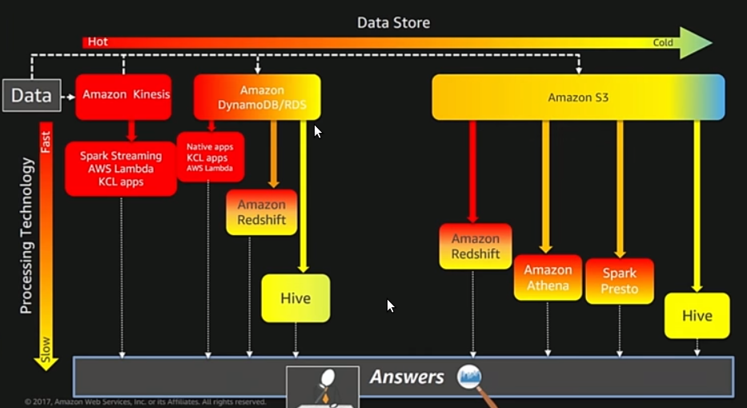
Anytics speed details

Slide 9
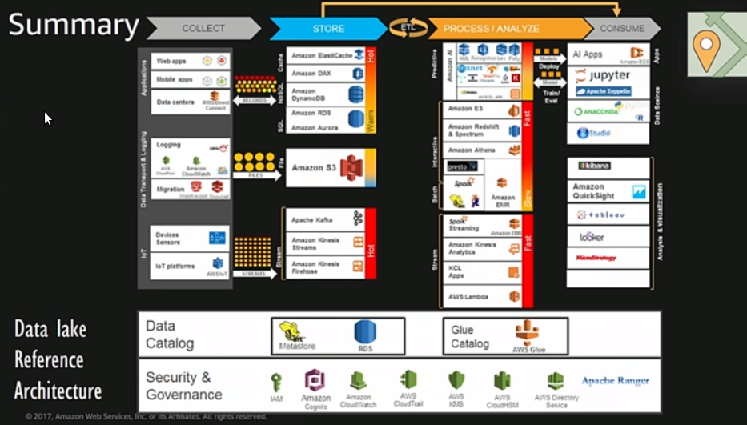
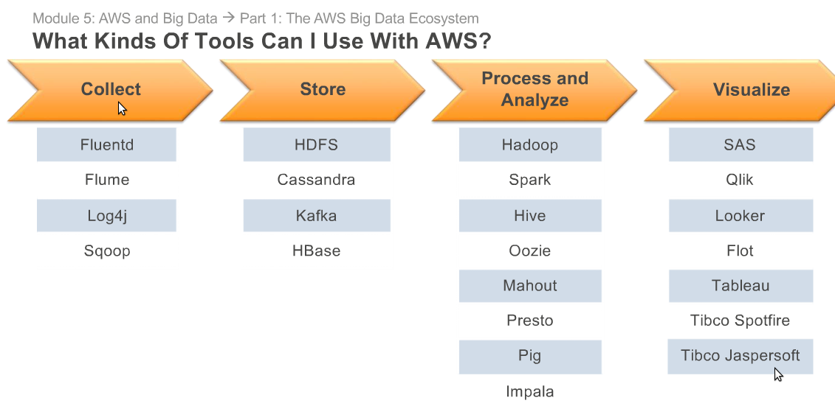
Applications vs Storage
Web app, Mobile app, data center | ElastiCache, DAX, DynamoDB, RDS, Aurora
Logging, migration | S3
IoT, device sensors | Kafka, Kinesis Streams, Kinesis firehose

Slide 10
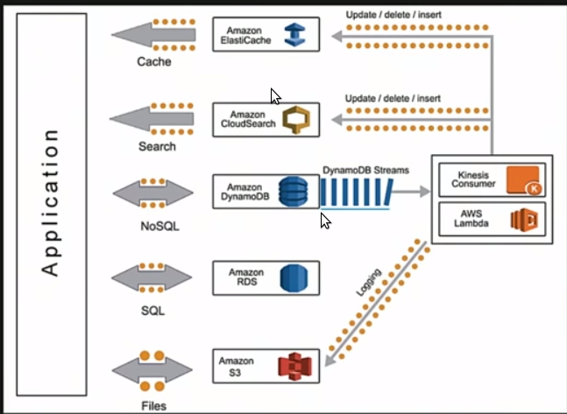
Architecture Event Sourcing / CQRS

Slide 11
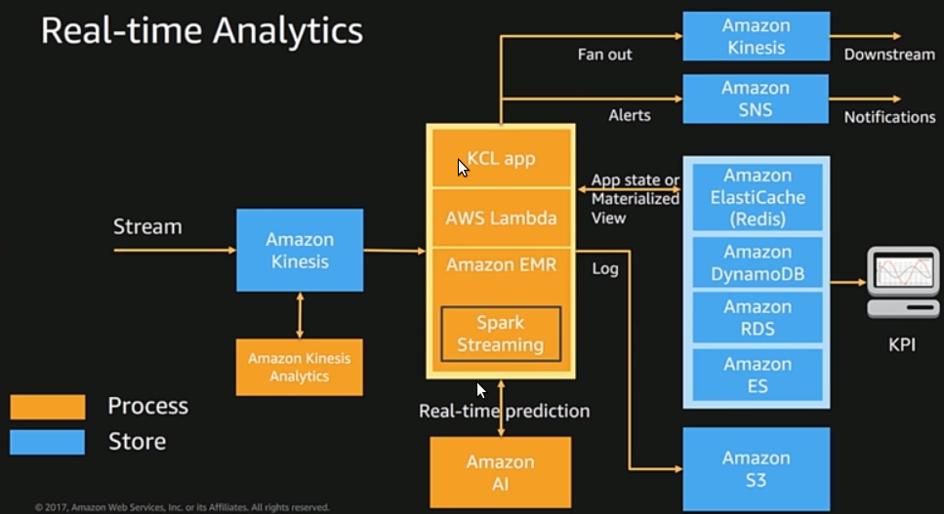
Architecture Realtime Analytics

Slide 12
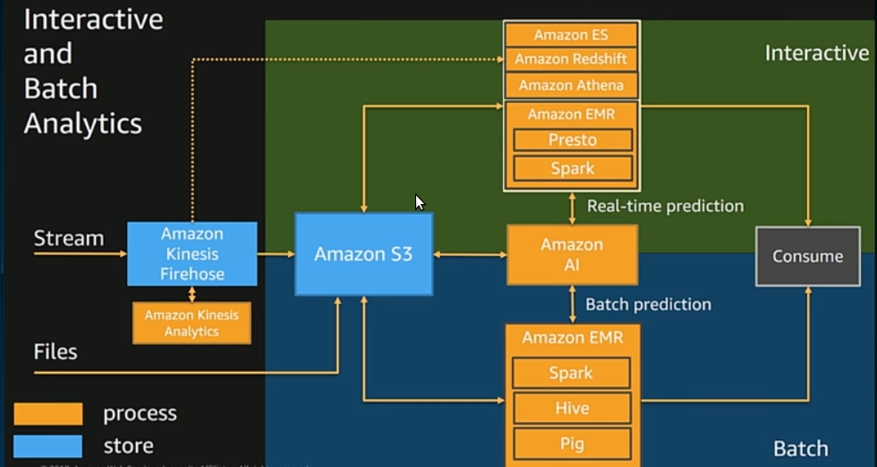
Architecture Interactive and Batch Analysis

Slide 13
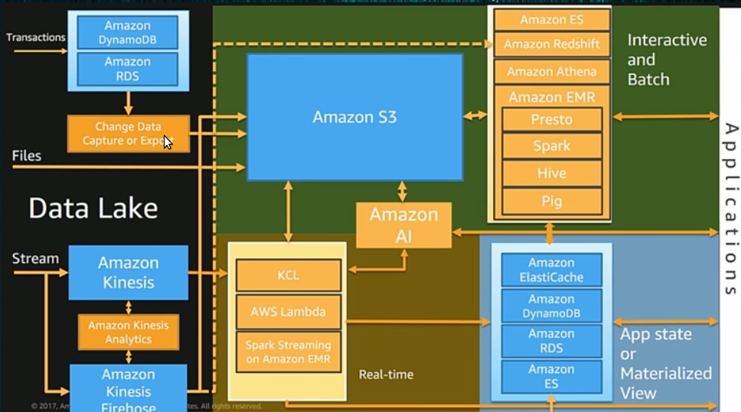
Architecture Data Lake

Slide 14
Big Data Domains
Media/Advertising | Targeted Ads, Image/Video processing
Oil & Gas | Seismic Analysis
Retail | Recommendations, Transactions
Life Science | Genome Analysis
Financial Services | Monte Carlo, Risk Analysis
Security | Anti-Virus, Fraud Detection, Image Recognition
Social network | User Demographics, Usage analysis, In-game metrics

Slide 15
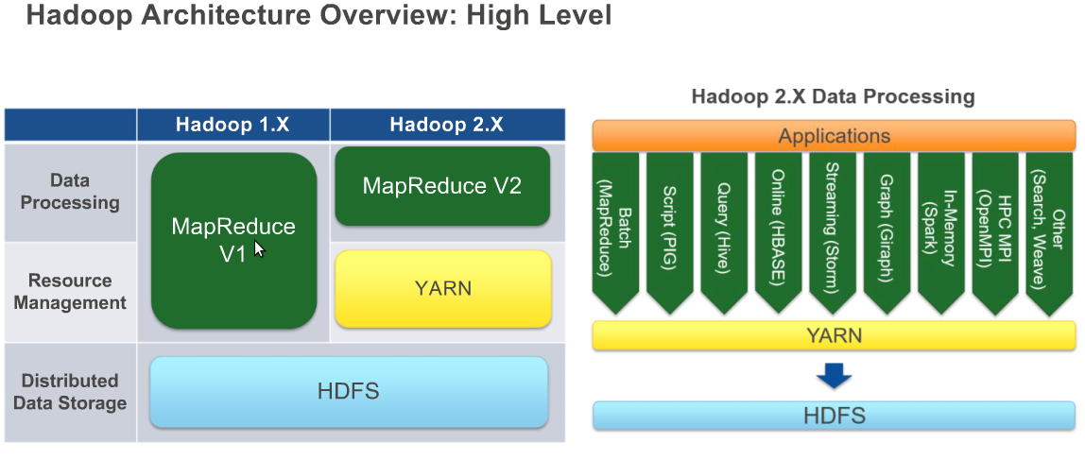
Hadoop Architecture

Slide 16
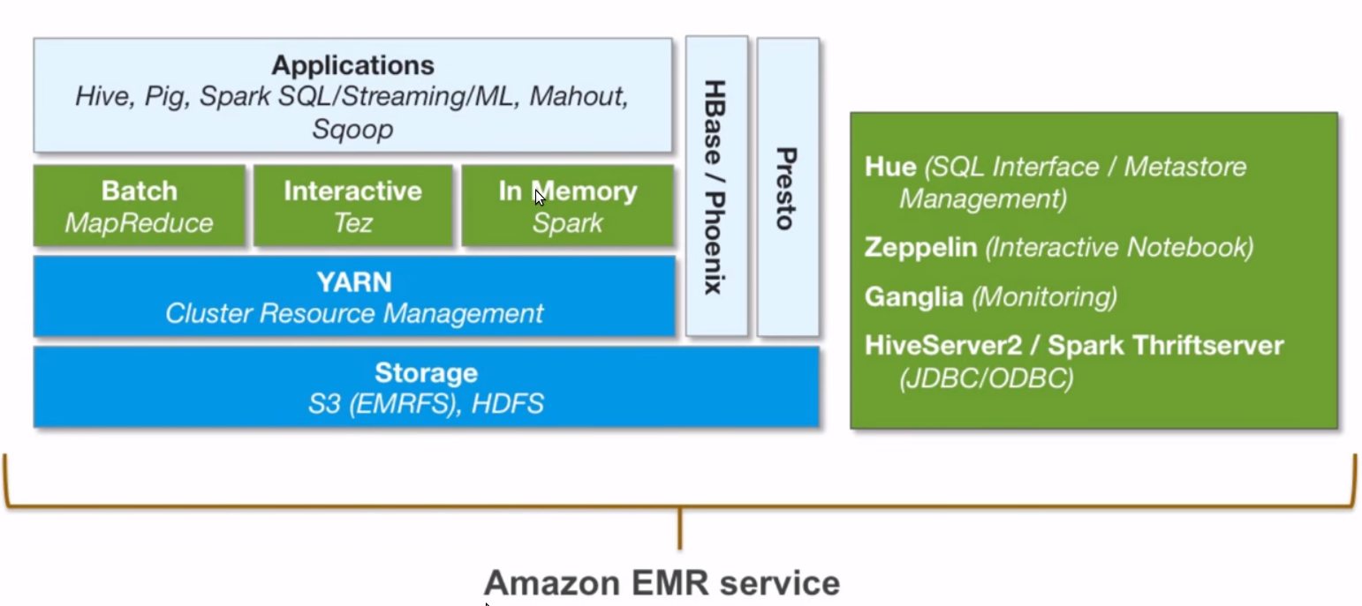
Hadoop applications

Slide 17
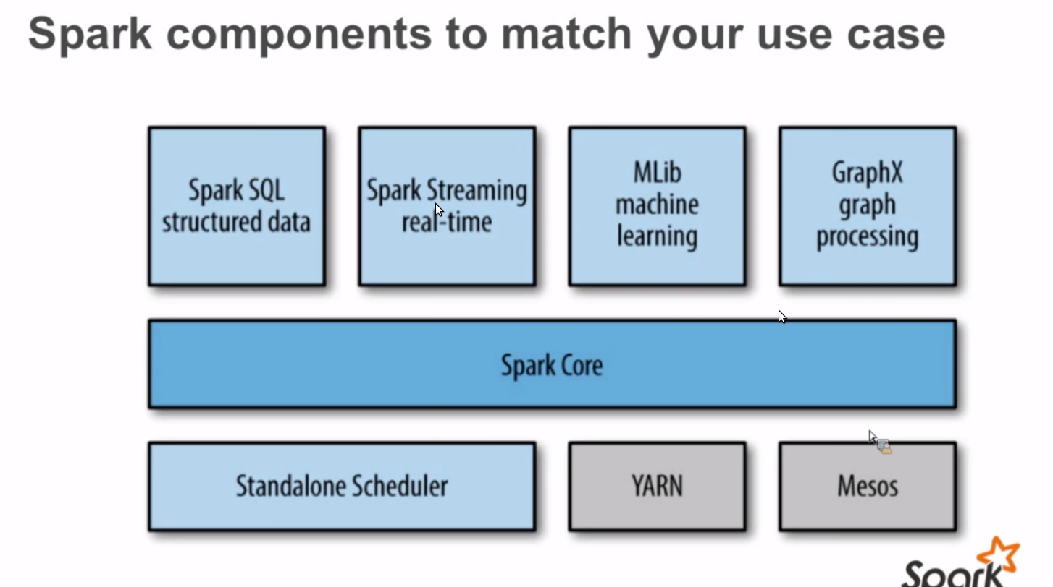
Spark Applications

Slide 18
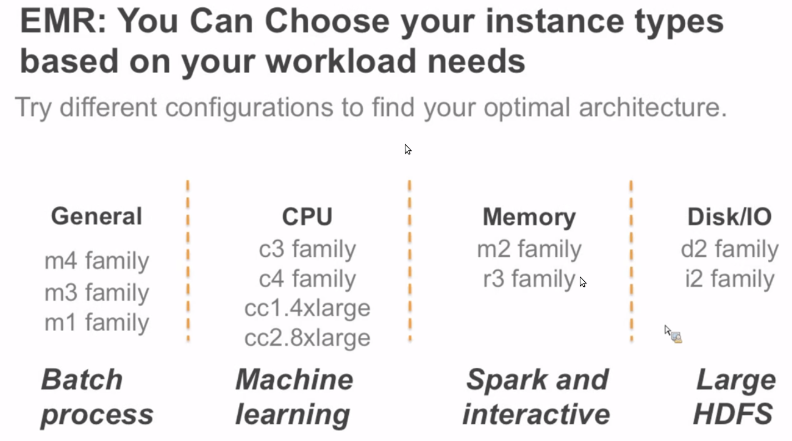
EC2 Machine families

